Slide 1

APEX INSTITUTE OF TECHNOLOGY
DEPARTMENT OF COMPUTER SCIENCE & ENGINEERING
Computer Organization & Architecture (21CSH-281)
Faculty: Siddharth Kumar (E12853)
Lecture – 25 & 26
Memory Organization: Cache Memory & Cache Size Vs. Block Size
DISCOVER . LEARN . EMPOWER

Slide 2
Computer Organization & Architecture: Course Objectives
COURSE OBJECTIVES
The course aims to:
The purpose of the course is to introduce principles of computer organization and the basic architectural concepts.
It begins with basic organization, design, and programming of a simple digital computer and introduces simple register transfer language to specify various computer operations.
Topics include computer arithmetic, instruction set design, microprogrammed control unit, pipelining and vector processing, memory organization and I/O systems, and multiprocessors.
To familiarize Students with the detailed Architectures of a Central Processing Unit.
Learn the different types of serial communication techniques.

Slide 3
COURSE OUTCOMES
On completion of this course, the students shall be able to:-
CO1 | Identify and interpret the basics of instruction sets and their impact on the design, organization, and functionality of various functional units of a computer comparable to the CPU, memory organization, I/O organization, and parallel processors.
CO2 | Analysis of the design of arithmetic & logic unit and understanding of the fixed point and floating-point arithmetic operations.
CO3 | Relate cost performance and design trade-offs in designing and constructing a computer processor which includes memory.
CO4 | Understanding the different ways of communicating with I/O devices and standard I/O interfaces.
CO5 | Implementation of control unit techniques and the concept of Pipelining.

Slide 4
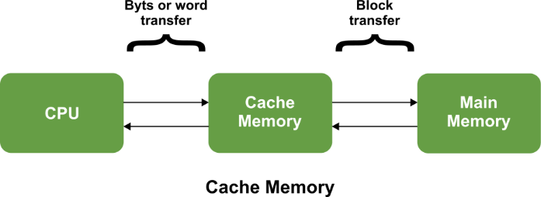
Cache Memory
The data or contents of the main memory that are used frequently by CPU are stored in the cache memory so that the processor can easily access that data in a shorter time. Whenever the CPU needs to access memory, it first checks the cache memory. If the data is not found in cache memory, then the CPU moves into the main memory. Cache memory is placed between the CPU and the main memory. The block diagram for a cache memory can be represented as:

Slide 5
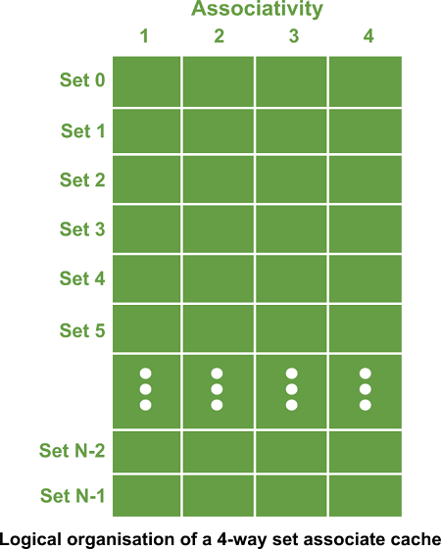
The cache is the fastest component in the memory hierarchy and approaches the speed of CPU components. Cache memory is organized as distinct set of blocks where each set contains a small fixed number of blocks.

Slide 6
As shown in the above sets are represented by the rows. The example contains N sets and each set contains four blocks. Whenever an access is made to cache, the cache controller does not search the entire cache in order to look for a match. Rather, the controller maps the address to a particular set of the cache and therefore searches only the set for a match.
If a required block is not found in that set, the block is not present in the cache and cache controller does not search it further. This kind of cache organization is called set associative because the cache is divided into distinct sets of blocks. As each set contains four blocks the cache is said to be four way set associative.
The basic operation of a cache memory is as follows:
• When the CPU needs to access memory, the cache is examined. If the word is found in the cache, it is read from the fast memory.
• If the word addressed by the CPU is not found in the cache, the main memory is accessed to read the word.

Slide 7
The basic operation of a cache memory is as follows:
• A block of words one just accessed is then transferred from main memory to cache memory. The block size may vary from one word (the one just accessed) to about 16 words adjacent to the one just accessed.
• The performance of the cache memory is frequently measured in terms of a quantity called hit ratio.
• When the CPU refers to memory and finds the word in cache, it is said to produce a hit.
• If the word is not found in the cache, it is in main memory and it counts as a miss.
• The ratio of the number of hits divided by the total CPU references to memory (hits plus misses) is the hit ratio.
Levels of memory:
Level 1: It is a type of memory in which data is stored and accepted that are immediately stored in CPU. Most commonly used register is accumulator, Program counter, address register etc.

Slide 8
Level 2: It is the fastest memory which has faster access time where data is temporarily stored for faster access.
Level 3: It is memory on which computer works currently. It is small in size and once power is off data no longer stays in this memory.
Level 4: It is external memory which is not as fast as main memory but data stays permanently in this memory.
Cache Organization: Block Size, Writes
Remember that the memory in a modern system has many levels of cache. Typically, the more data that the memory can store, the slower it is. It turns out that a third of the core of a processor is a cache. For each cache line, you have:
• 1-bit valid bit
• 4-bit tag bits
• 8-bit data bits

Slide 9
This has 5 bits of overhead for every 8 bits of data! This is a problem. How do we reduce this? What if instead of storing one byte per tag, we stored multiple bytes per tag?
Advantages:
• Increase the data
• Reduce the bits needed per tag
• Can get a higher hit rate by bringing sequential values to higher cache level (loops!)
Let's say you have 16 memory addresses, and originally a block size of 1. If you double the block size, the tag space is halved and hence you can actually shave a bit off of the tag field!

Slide 10
Block Offset Size vs. Tag Size
You have to store the tag and the block offset together. Let's say that you have 32 bits to do so. Let's look at a couple scenarios to determine how big the tag needs to be, and how big the block offset needs to be.
If your blocks have a size of one byte, then you do not need to store a block offset whatsoever. The tag size is 32 bits, and block offset size is 0 bits.
If your blocks have a size of two bytes, then you have to store a single bit for the block offset, and you have to use the remaining bits for the tag. The tag size is then 31 bits, and block offset size is 1 bit.
In general, the block offset size is always going to be log₂(b), where b is your block size in bytes. The tag size will always be the number of bits for the address (tag + offset), minus the block offset size.
Where does the best equilibrium lie? How big should the block size be to maximize locality?
Deciding on Block Size
Let's say that you have a super huge block size. If the block size is on the scale of your cache, then you only have one cache line. This is really inefficient. On the other hand, if your block size is one byte, you have to do a lot of repeated loads. How do we decide the best block size?

Slide 11
It turns out, computer engineers just take a bunch of applications that they believe are representative of what their processor will run in real life, and they simulate the performance of different cache sizes.
Most systems use a block size between 32 bytes and 128 bytes. These longer sizes reduce the overhead by:
• Reducing the number of CAM entries
• Reducing the size of each CAM entry
Keeping Track of LRU
When you load something from the memory into the cache, you have to replace the least recently used block. To keep track of this, hardware keeps a list. To store this ordering, you need some bits to store the ordering of the cache lines in the LRU list.
Bits needed
Since you need to store a number for each cache line entry, this amounts to: log₂(l), Where l is the number of cache lines you have.

Slide 12
Summary
Discussed about the Cache memory.
Discussed about the Cache size vs. block size.
Assessment Questions
Q1. What are the differences between Cache size &. block size?
Q2. What are the types of Cache memory and usages?

Slide 13
THANK YOU

